Slide 1
Development of master curricula for natural disasters risk management in Western Balkan countries
NatRisk project
Project number: 573806-EPP-1-2016-1-RS-EPPKA2-CBHE-JP
"This project has been funded with support from the European Commission. This publication reflects the views only of the author, and the Commission cannot be held responsible for any use which may be made of the information contained therein"

Slide 2
Basic Information
Development of master curricula for natural disasters risk management in Western Balkan countries
Contract number 573806-EPP-1-2016-1-RS-EPPKA2-CBHE-JP
Project acronym NatRisk
Project name Development of master curricula for natural disasters risk management in Western Balkan countries
Project duration 15th October 2016 - 14th October 2019
Programme ERASMUS+ – Call for Proposals EAC/A04/2015
Total cost 1,245,746.00 €
Coordinator University of Niš, Serbia
Univerzitetski trg 2, 18000 Niš, Serbia
Project website www.natrisk.ni.ac.rs
Project e-mail natriskuni@gmail.com

Slide 3
Overall Broader Objective
Development of master curricula for natural disasters risk management in Western Balkan countries
Education of experts for prevention and management of natural disasters in the region of Western Balkan (WB) according to the national and EU policies.

Slide 4
Specific Objectives
Development of master curricula for natural disasters risk management in Western Balkan countries
Development and implementation of methodology for identification of natural disasters to be managed in WB region and all aspects of prevention and consequences in order to define specific competencies for professional practice
Development and implementation of the new advanced master curricula in Natural Disasters Risk Management (NDRM) in line with the Bologna requirements and national accreditation standards
Development of trainings for the public sector and citizens for reaction in case of various natural disasters

Slide 5
Consortium
Development of master curricula for natural disasters risk management in Western Balkan countries
EU partners
University of Natural Resources and Life Sciences, Vienna (BOKU, AUSTRIA)
Middlesex University Higher Education Corporation (MUHEC, UK)
University of Messina (UNIME, ITALY)
Óbuda University (OE, HUNGARY)
Technical University of Crete, Chania (TUC, GREECE)

Slide 6
Consortium
Development of master curricula for natural disasters risk management in Western Balkan countries
Western Balkan partners
University of Niš (UNI, Serbia)
Academy of Criminalistics and Police Studies (KPA, Serbia)
University of Pristina in Kosovska Mitrovica (UPKM, Kosovo*)
University of Sarajevo (UNSA, Bosnia and Herzegovina)
University of Banja Luka
Technical College of Applied Sciences Urosevac with temporary seat in Leposavic (TCASU, Kosovo*)
University of Defence in Belgrade (UNID, Serbia)

Slide 7
Consortium
Development of master curricula for natural disasters risk management in Western Balkan countries
Associated partner
Republic Hydrometeorological Service of Serbia

Slide 8
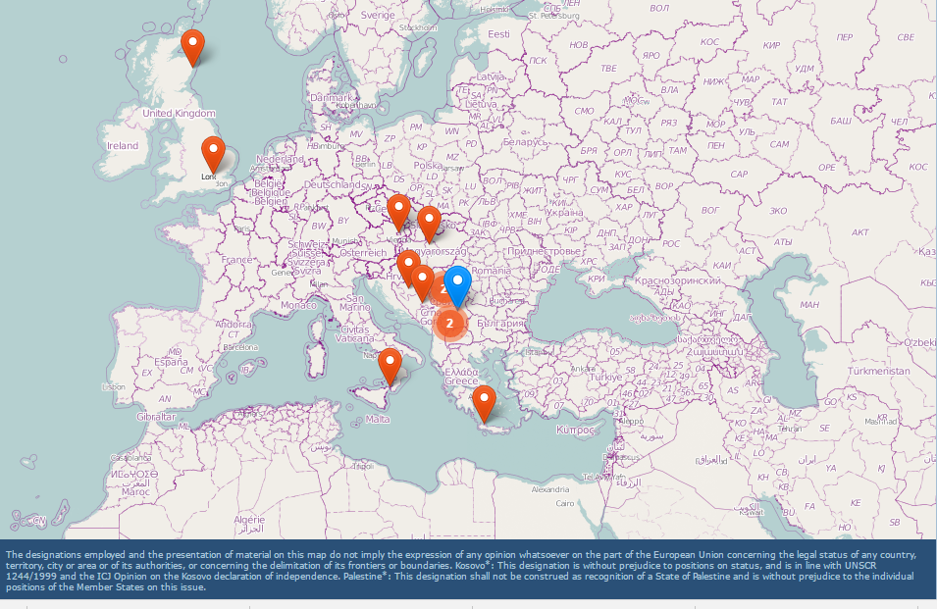
Development of master curricula for natural disasters risk management in Western Balkan countries
NatRisk Map
Source: http://ec.europa.eu/programmes/erasmus-plus/projects/eplus-project-details-page/?nodeRef=workspace://SpacesStore/c3a0d5cf-9f44-40b1-8731-23c187fc13ee

Slide 9
Work Packages
Development of master curricula for natural disasters risk management in Western Balkan countries
Preparation WP1: Analysis of natural disasters needed to be managed in Western Balkan region
Leader: University of Natural Resources and Life Sciences, Vienna
Preparation WP2: Development of master curricula
Leader: University of Messina
Preparation WP3: Development of trainings for citizens and public sector
Leader: University of Defence in Belgrade
Development WP4: Implementation of developed master curricula and trainings
Leader: University of Sarajevo

Slide 10
Work Packages
Development of master curricula for natural disasters risk management in Western Balkan countries
Quality Plan WP5: Quality assurance and monitoring
Leader: Middlesex University Higher Education Corporation
Dissemination & Exploitation WP6: Dissemination
Leader: University of Niš
Dissemination & Exploitation WP7: Exploitation
Leader: University of Niš
Management WP8: Project management
Leader: University of Niš

